Slide 1
Sergej Ruff
Developing your own R Package
Introduction to R Package Development
Notes:
- Over the last few months I compiled some functions from different packages into one big r package.
Today I want to give a tutorial on how you can develop your own r package

Slide 2
Developing your own R Package – Contents
Developing your own R Package – Motivation
Developing your own R Package – Packages
Developing your own R Package – general steps
Set up your package directory
Write the package documentation
Creating the documentation for your function
Dependencies and the NAMESPACE-File
Dependencies and the DESCRIPTION-File
Set up the package DESCRIPTION File
check and build the package
Some common mistakes and errors

Slide 3
Developing your own R Package – Motivation
Why should you creat your own r packages?
Code reuse and sharing
By packaging your R code into a well-defined package, it becomes easier to reuse and share your code with others.
2. Saves Time
others can use and build on your code, rather than reinventing the wheel.
3. Code organization
Developing a package can help you to organize your own code more effectively, making it easier to maintain and update your code over time.
4. Reproducibility
By packaging your code and data into a self-contained package, you can ensure that your research and analyses are reproducible by others.
Overall, R packages provide a powerful and flexible framework for developing, sharing, and collaborating on code in R.
Marwick, B., Boettiger, C., & Mullen, L. (2018). Packaging data analytical work reproducibly using R (and friends). The American Statistician, 72(1), 80-88.
Notes:
First -> Why do we need to creat r packages?
What is there to gain for us?
First – functions become reusable by others once you compile them into packages.
Which also enables you to share your functions with others across the globe.
Those people across the globe can then use your functions and recreat your work without reinventing the wheel each time
In a manner that’s organized.
We see that R packages enable a framework for developing r packages, sharing of code and teamwork.

Slide 4
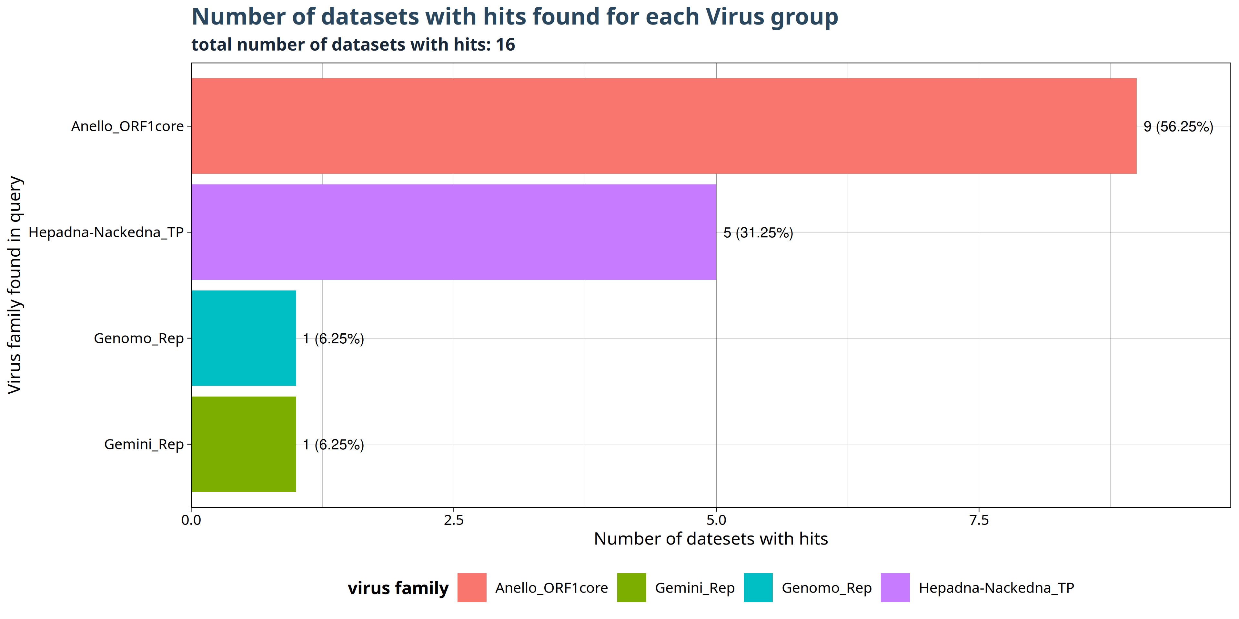
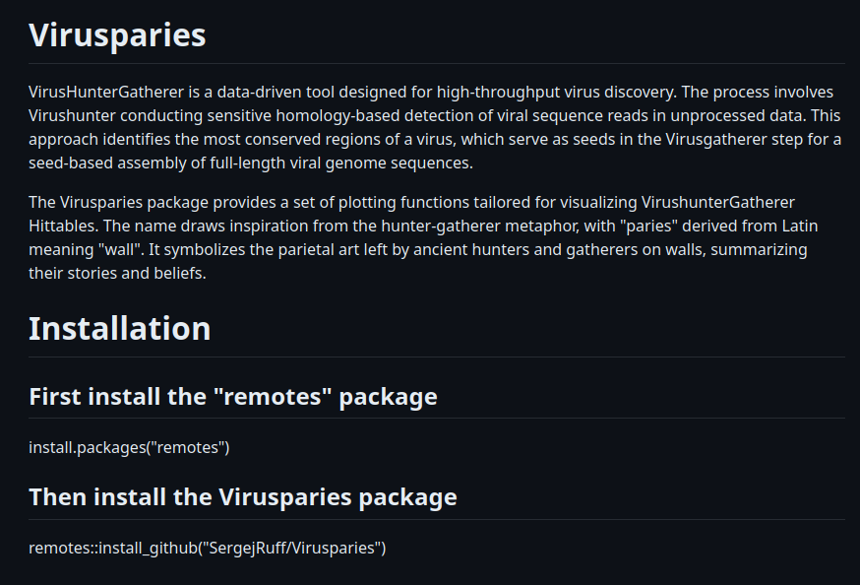
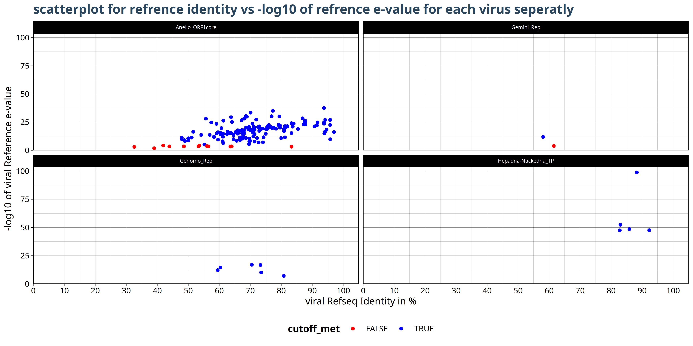
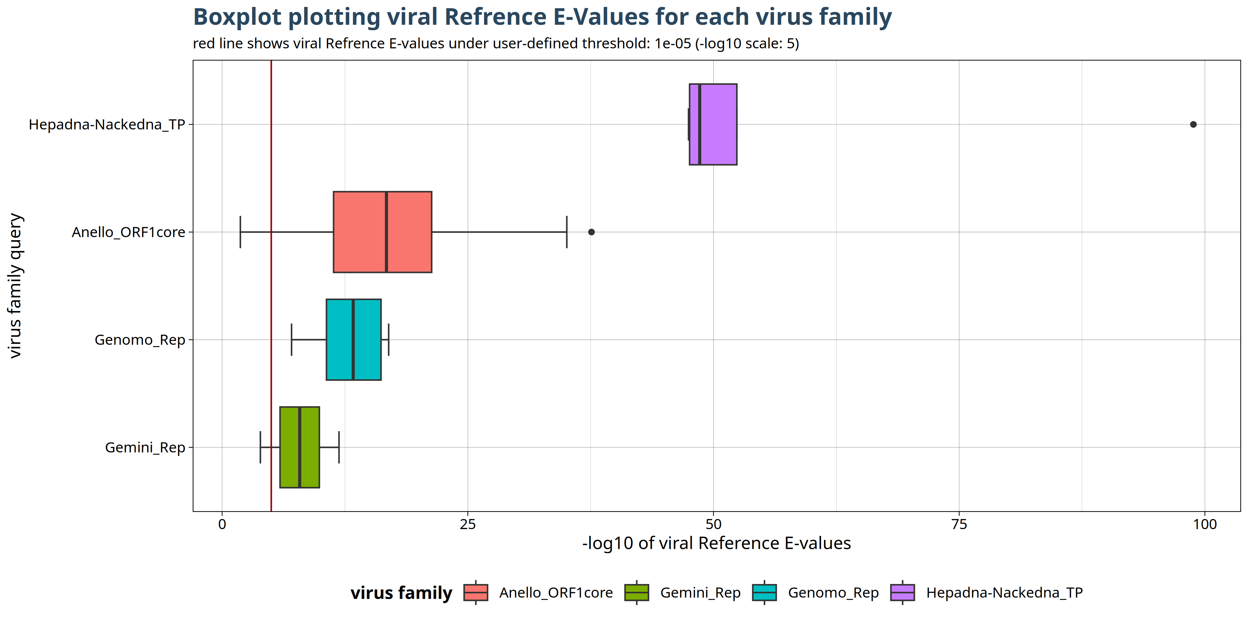
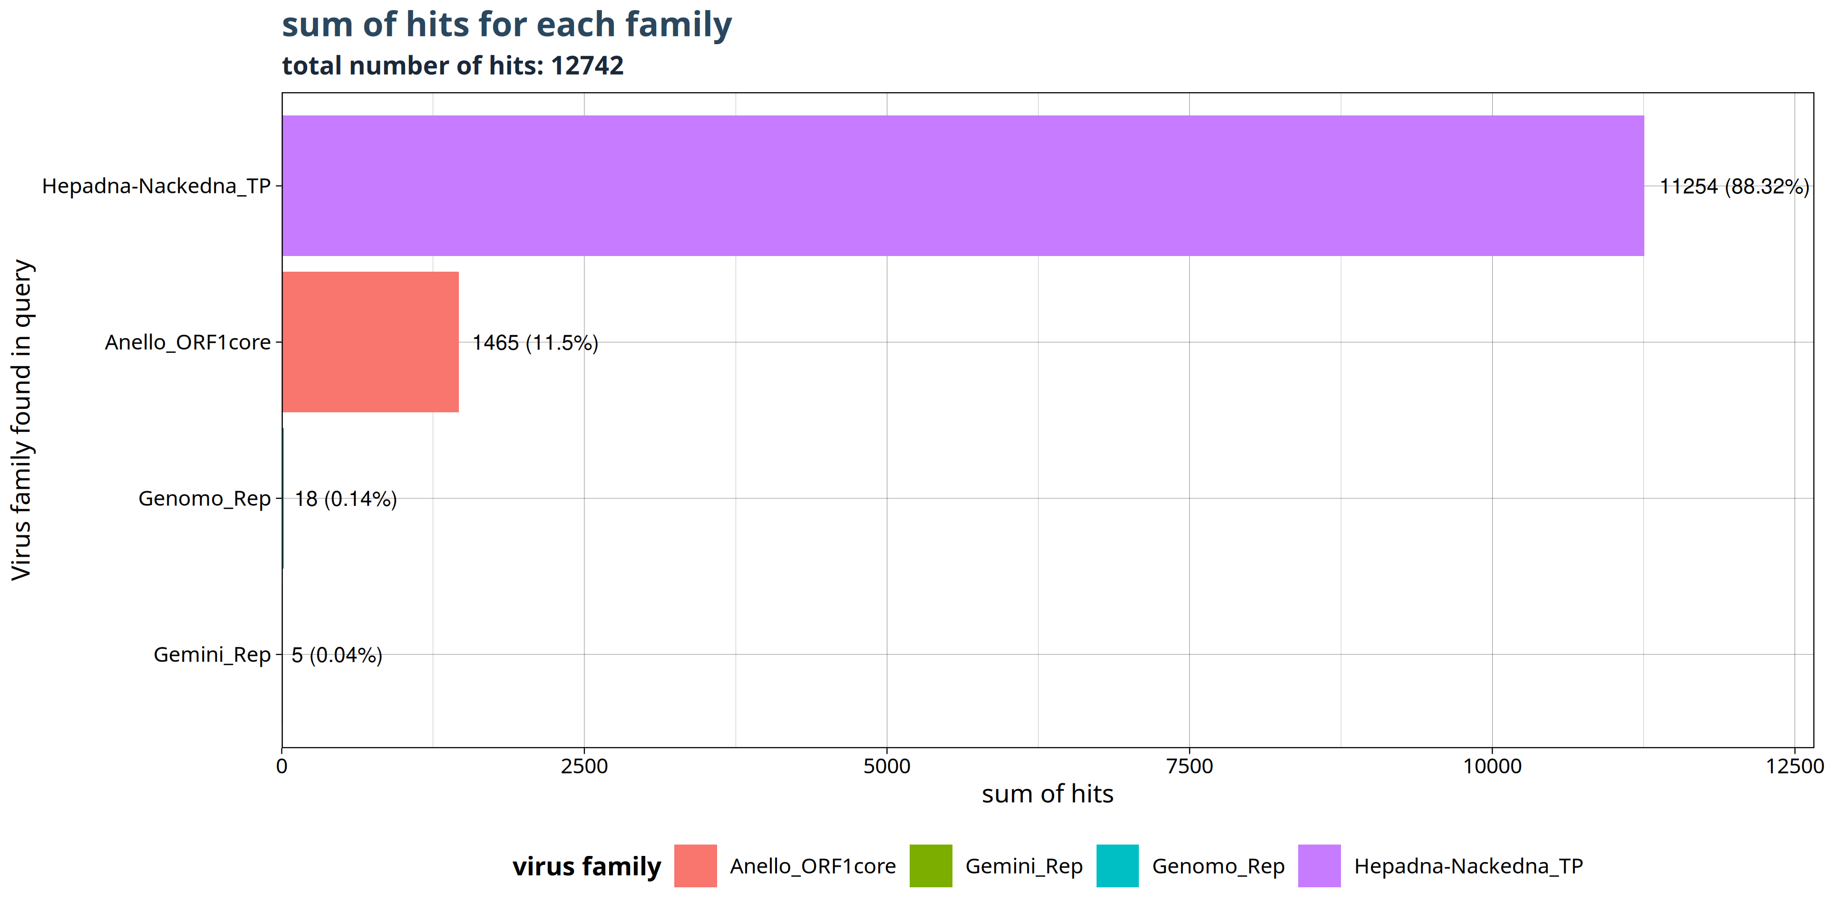
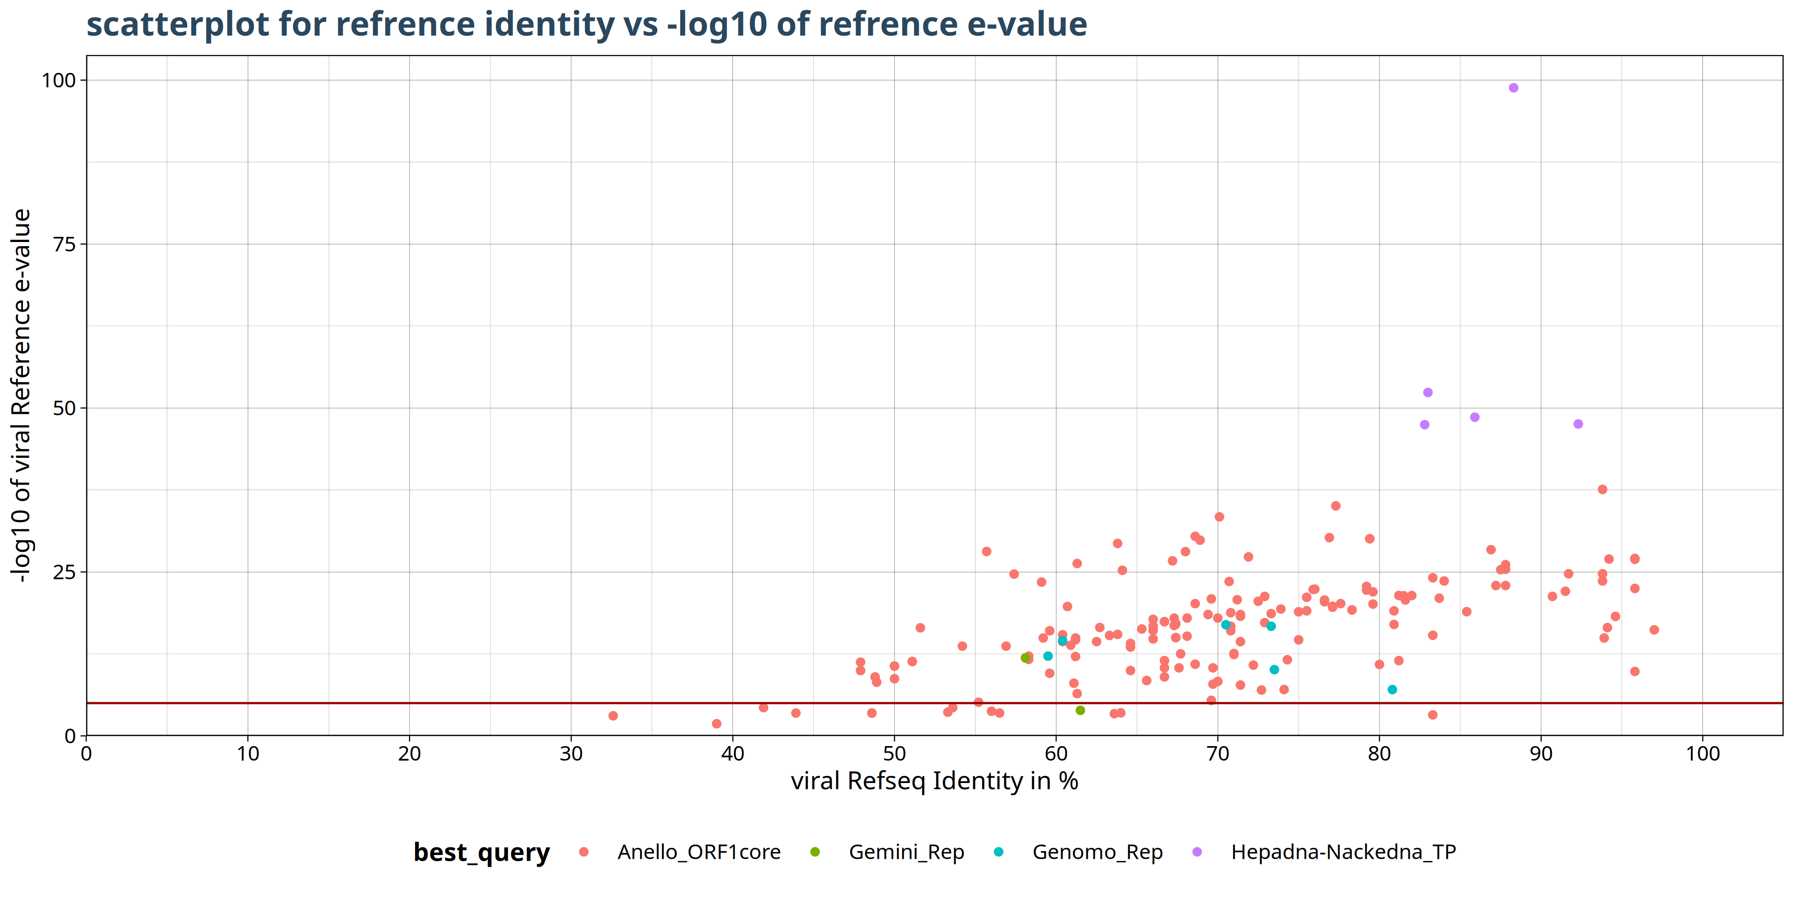
Real Example: Virusparies
https://github.com/SergejRuff/Virusparies

Slide 5
Developing your own R Package – Packages
Hadley Wickham, Peter Danenberg, Gábor Csárdi and Manuel Eugster (2022). roxygen2: In-Line Documentation for R. R package version 7.2.3. https://CRAN.R-project.org/package=roxygen2
library ( "roxygen2" )
Version: 7.2.3
library ( "devtools" )
Version: 2.4.5
library ( "usethis" )
Version: 2.1.6
R
Version: 4.1.3 (2022-03-10)
RStudio
Version: 2023.03.0+386
Hadley Wickham, Jim Hester, Winston Chang and Jennifer Bryan (2022). devtools: Tools to Make Developing R Packages Easier. R package version 2.4.5. https://CRAN.R-project.org/package=devtools
Hadley Wickham, Jennifer Bryan and Malcolm Barrett (2022). usethis: Automate Package and Project Setup. R package version 2.1.6. https://CRAN.R-project.org/package=usethis
R Core Team (2022). R: A language and environment for statistical computing. R Foundation for Statistical Computing, Vienna,
Austria. URL https://www.R-project.org/.
Posit team (2023). RStudio: Integrated Development Environment for R. Posit Software, PBC, Boston, MA. URL http://www.posit.co/.
Notes:
Here you can see the 3 basic packages you need to creat a r package.
Roxygen2 ist here to provide Tags and a framework for package documentation
Devtools is a tool that make R package development easier
Usethis –is great for DESCRIPTION-FILE Editing
RStudio has many functions of roxygen and Devtools already implemented

Slide 6
Developing your own R Package – general steps
The 7 Steps of Developing your own R Package
Set up your package directory
5. Build the package
2. Write the package code
4. Set up the package DESCRIPTION file
6. Test and check the package
3. Write the package documentation
7. Share the package
Wickham, H. (2015). R packages: organize, test, document, and share your code. " O'Reilly Media, Inc.". (Modified)
Notes:
7 Steps of Development - use as a framework for this prasentation
No 2 – because you have to write your own code.
Barely any 7 – depends on where you submit which Rules you have to follow and I have to submit myself.

Slide 7
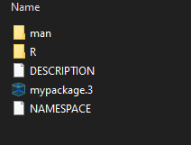
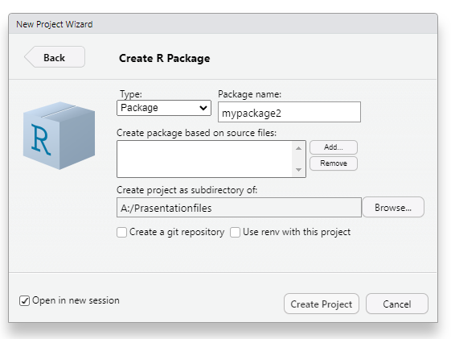
Set up your package directory
Creat a new directory for your package
2 Methods to creat a new directory for your package
The Structure of your package directory is the same
Using RStudio
File -> New Project... -> New Directory -> R Package
library(devtools)
devtools::create("A:/Prasentationfiles/mypackage")
Letters (upper or lowercase)
Numbers (0-9)
Dots (.) for separating words
R: This directory will contain all of your R code files.
man: This directory will contain the documentation for your package functions.
DESCRIPTION: contains metadata about your package
NAMESPACE: controls visibility and scope of objects
path
Notes:
Lets start with the first step of 7 – We need to creat a directory for our package.
2 methods
You are allowed to use letters, numbers and a dot but not at the beginning of the package name
Meaning mypackageDOT2 is allowed DOTmypackage2 is not.
Any other special characters are not allowed here. So no package names with dollar-signs
No matter what method you use the structure of your package should look the same. The same 4-5 files or subfolders.

Slide 8
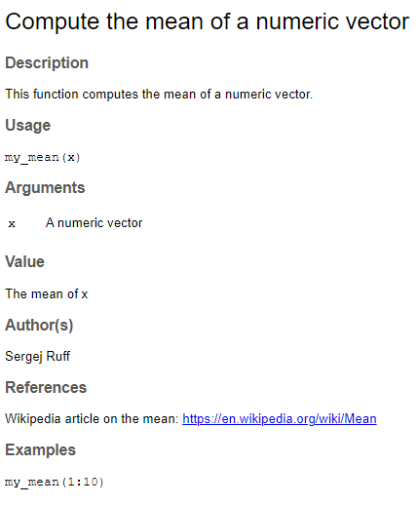
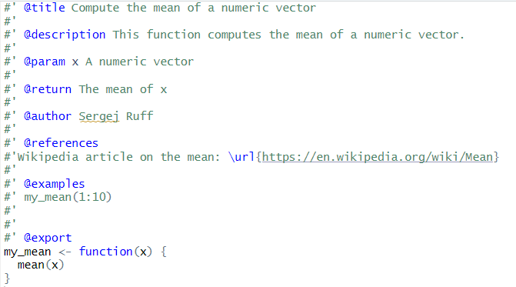
Write the package documentation
Write the documentation for your package functions and save them in the "man" subdirectory
R uses roxygen Tags and #' for documentation of a function
@title: the title of the function
@description: provides a more detailed description of what the function does.
@param: This tag is used to document the function's arguments.
@return: This tag describes the value that the function returns.
@author: author or authors of the function.
@references: This tag provides references or links to any external sources
@examples: provides examples of how to use the function.
@export: This tag tells R that this function should be exported from the package and made available to users.
! Each argument needs a new @param and you need to provide Information about the argument
The #' symbol in Roxygen is used to indicate documentation lines for a function
Notes:
Once we set up a folder for our package
We can start creating scripts with functions.
And each package functions has documentation. Meaning we need to provide said documentation.
# Single Quotations Sign shows where you package documentation starts and ends
And the tags separate you documentation into segments and do different tasks.
R uses roxygen Tags and # Single Quote for documentation.
You can see here the bare minimum of tags
You can see here what that documentation would look like when your package is done.

Slide 9
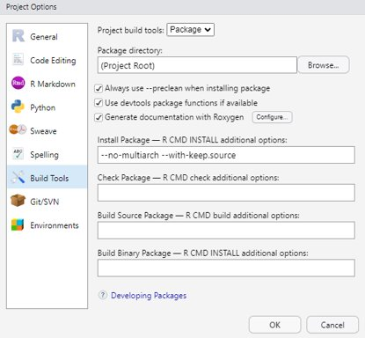
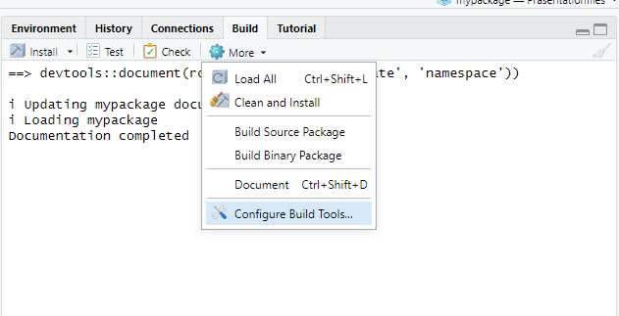
Creating the documentation for your function
You need devtools to creat a documentation file for your function in the 'man'-subdirectory
There are 2 Methods:
library(devtools)
devtools::document()
Using RStudio
Build -> More -> Configure Build Tools...
-> Generate documentation with Roxygen
Generates Help-Files for each function
Updates the NAMESPACE file to reflect any changes in exported functions or imported packages
Notes:
Writing down the documentation alone is not enough.
We need to generate help-files for each function and update our namespace.
Two methods.
The document function uses the provided Roxygentags and documentation to creat Helper files and Namespace changes.

Slide 10
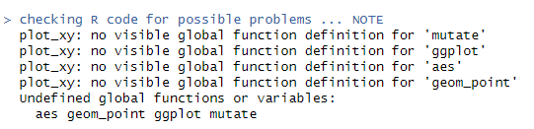
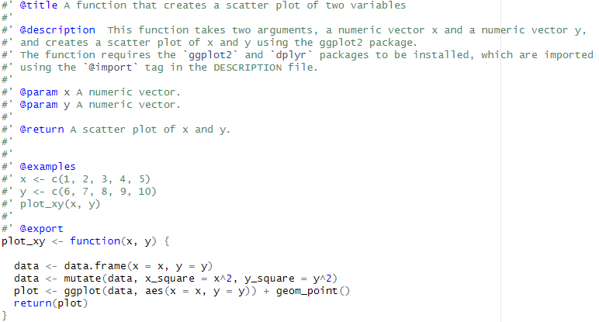
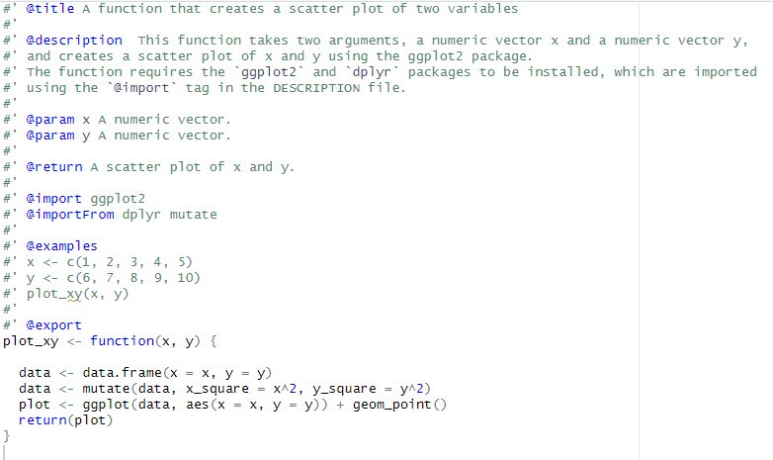
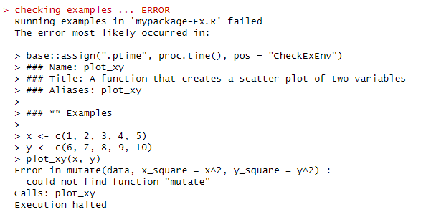
Dependencies and the NAMESPACE-File
Dependency – refers to a package that your package relies on to function properly
Dependencies are specified in NAMESPACE and DESCRIPTION-File
Reason:
Did not declare the dependency in the NAMESPACE-File !
Solution:
Declare Dependencies and document()
Devtools::document() scans packages and updates the NAMESPACE-File based on @Import or @ImportFrom
! Do not edit the NAMESPACE-File
Manually!
Example – code uses dplyr and ggplot2 as a dependency
R Core Team. (2021). Writing R extensions. R Foundation for Statistical Computing, Vienna, Austria. URL https://CRAN. R-Project. org/doc/manuals/R-exts. html.
Notes:
Sometimes your package relies on other available packages to work properly. Those are called dependencies.
Those dependencies need to documented in the NAMESPACE and the DECRIPTION-File for your package to work.
Here for example my function uses mutate and ggplot.
But if we run the check we get the following to errors – see prasentation.
Those errors show us, that the dependencies need to be added to NAMESPACE-File
The NameSpace File includs information on which functions need to be exported to the end-user.
Meaning those functions become available and visable to the end-user.
For that we have the @export tag
The imports show every dependency we need. We use @import for entire packages and @importFrom for specific functions we need.

Slide 11
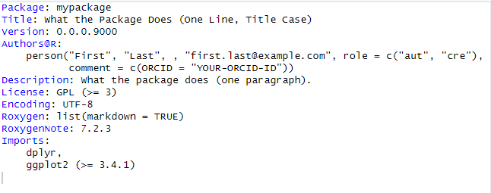
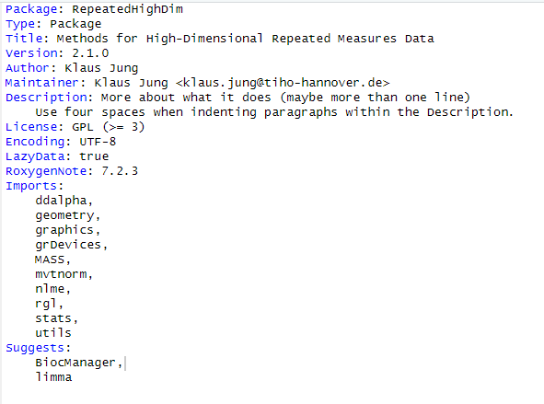
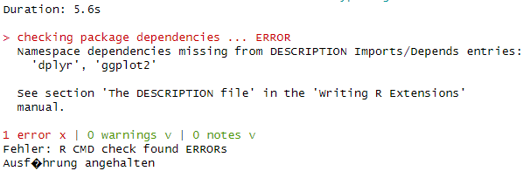
Dependencies and the DESCRIPTION-File
Dependencies are specified in NAMESPACE and DESCRIPTION-File
Imports
packages that are required for your package to function properly.
Only loads the packages
Depends
This field is used to list packages that are required for your package to function properly
Loads and attaches to search path
Suggests -
This field is used to list packages that are not required for your package to function properly, but may be useful for the user.
Packages required for Examples
library(usethis)
usethis::use_package("dplyr",
type="Imports")
usethis::use_package("ggplot2",
type="Imports",min_version = "3.4.1")
NAMESPACE-File alone is not enough
You need to edit the DESCRIPTION-File!
https://blog.thatbuthow.com/how-r-searches-and-finds-stuff/
01.05.2023 17:19
R Core Team. (2021). Writing R extensions. R Foundation for Statistical Computing, Vienna, Austria. URL https://CRAN. R-Project. org/doc/manuals/R-exts. html.
Notes:
We also need to provide dependencies to the DESCRIPTION File.
Otherwise we get the following error.
Dependencies have their own fields in the DESCRIPTION-File based on what kind of dependency you require.

Slide 12
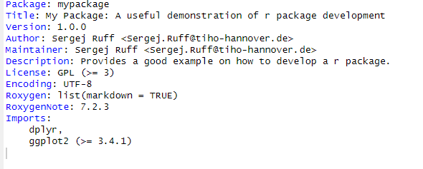
Set up the package DESCRIPTION File
CRAN requires a complete and informative DESCRIPTION file
D
usethis::use_version()
usethis::use_lgpl_license()
Description field:
One paragraph description of what the package does and why it may be useful
details about the package functionality and implemented methods
package names, software names and API names = single quotes
Please do not start the description with
"This package",
"Functions for",
package name,
title or similar.
Notes:
DESCRIPTION-File contains Metadata about our package.
The first submission of your package will contain manual checks. Meaning someone will controls the description file and reject your package if your description field written in a way they don’t like.

Slide 13
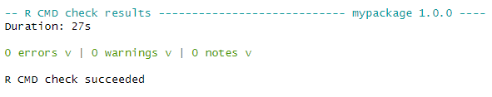
check and build the package
2 Methods to check your package
devtools::check()
Using RStudio
Build -> Check
CRAN requires a R CMD build
2 Methods to build your package
devtools::build()
Using RStudio
Build -> Build Source Package
This will generate a .tar.gz file which can be submitted to CRAN.
GOAL !
Notes:
You should check your packages frequently.
I recommend to check it at least everytime you implement a new function.
And you have to methods.
Once you archived your goal you can build a package and submit.

Slide 14
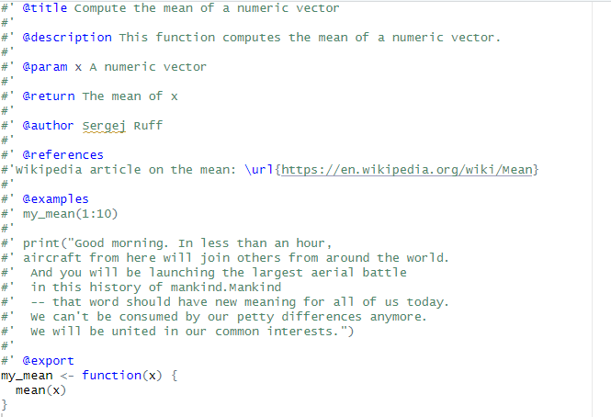
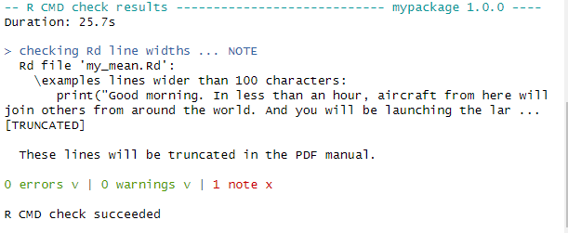
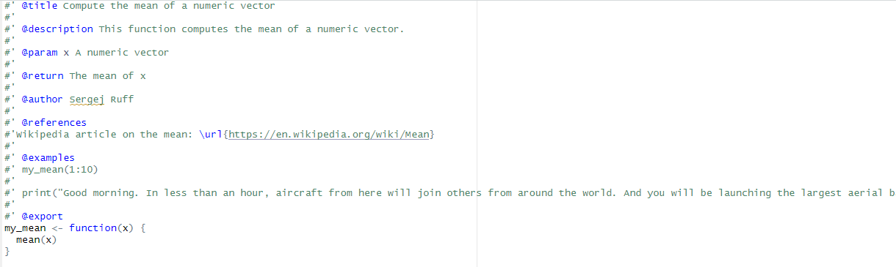
Commom Mistake #1 – character limits
Simple Solution – make sure the code doesn't exceed 100 characters.
R documentation has a maximum line width of 100 characters
The print-function exceeds 100 characters
Notes:
Here I want to go over some common error, warnings and maybe tips I encountered.

Slide 15
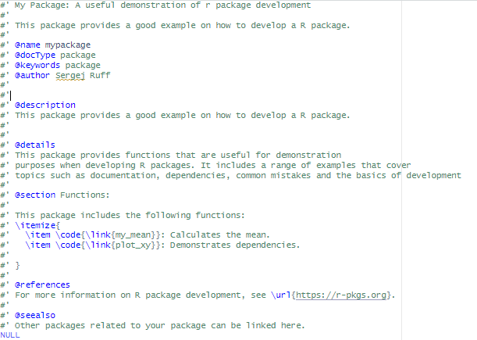
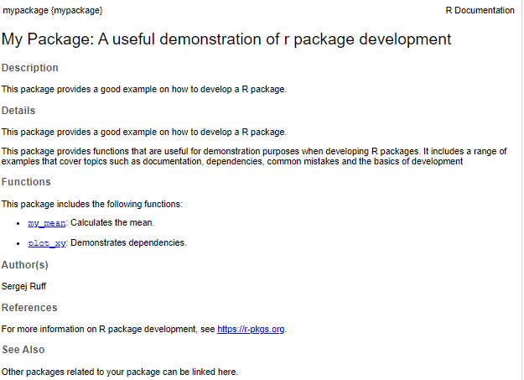
Commom Mistake #2 - ? + packagename doesn´t work
> ?mypackage
No documentation for ‘mypackage’ in specified packages and libraries:
you could try ‘??mypackage’
Each packages needs a package-level documentation!
And you need to provide the documentation
Creat a new R script with the name packagename-package.R

Slide 16
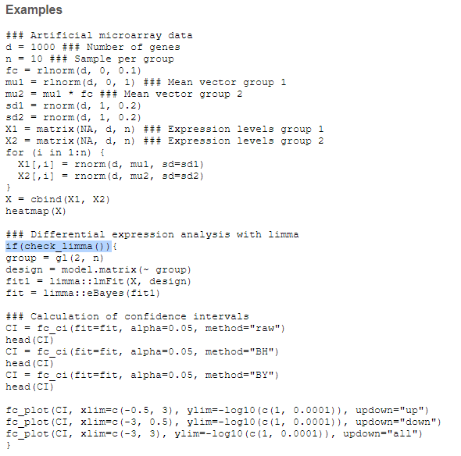
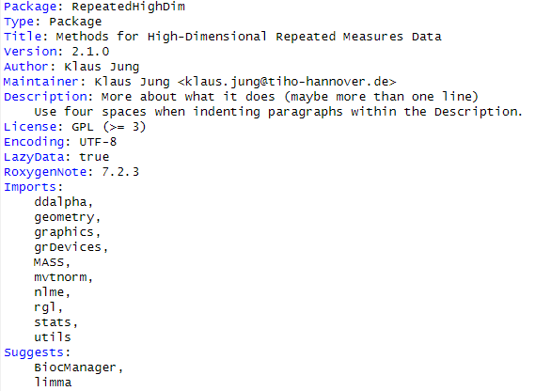
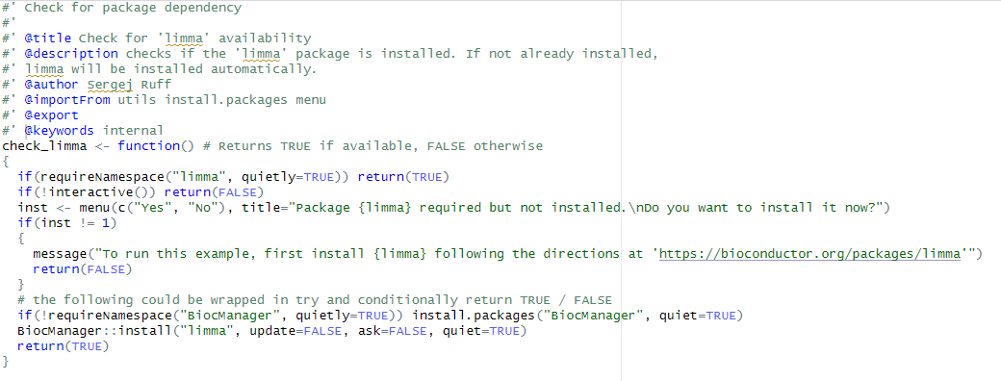
How to use Bioconductor Dependencies and Suggested Dependencies
It's recommended to make the use of Suggested Dependencies conditional via if(require("pkgname")):
Example
Limma Bioconductor dependency in Suggests
R Core Team. (2021). Writing R extensions. R Foundation for Statistical Computing, Vienna, Austria. URL https://CRAN. R-Project. org/doc/manuals/R-exts. html.

Slide 17
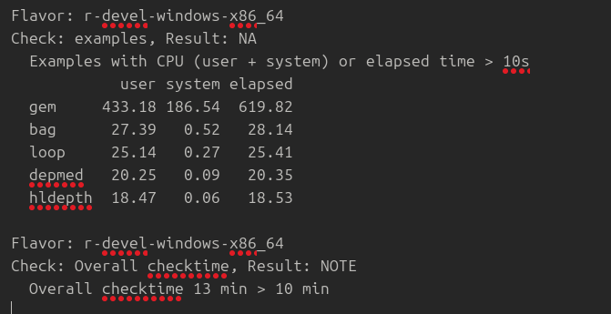
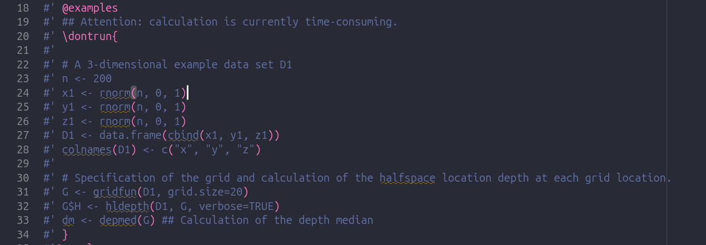
Commom Mistake #3 - „Examples should run for no more than a few seconds each“ – CRAN Repository Policy
Use \dontrun{}

Slide 18
Sources
https://blog.thatbuthow.com/how-r-searches-and-finds-stuff/ 01.05.2023 17:19
Hadley Wickham, Peter Danenberg, Gábor Csárdi and Manuel Eugster (2022). roxygen2: In-Line Documentation for R. R package version 7.2.3. https://CRAN.R-project.org/package=roxygen2
Hadley Wickham, Jim Hester, Winston Chang and Jennifer Bryan (2022). devtools: Tools to Make Developing R Packages Easier. R package version 2.4.5. https://CRAN.R-project.org/package=devtools
Hadley Wickham, Jennifer Bryan and Malcolm Barrett (2022). usethis: Automate Package and Project Setup. R package version 2.1.6. https://CRAN.R-project.org/package=usethis
Marwick, B., Boettiger, C., & Mullen, L. (2018). Packaging data analytical work reproducibly using R (and friends). The American Statistician, 72(1), 80-88.
Posit team (2023). RStudio: Integrated Development Environment for R. Posit Software, PBC, Boston, MA. URL http://www.posit.co/.
R Core Team (2022). R: A language and environment for statistical computing. R Foundation for Statistical Computing, Vienna, Austria. URL https://www.R-project.org/.
R Core Team. (2021). Writing R extensions. R Foundation for Statistical Computing, Vienna, Austria. URL https://CRAN. R-Project. org/doc/manuals/R-exts. Html.
Wickham, H. (2015). R packages: organize, test, document, and share your code. " O'Reilly Media, Inc.".

